Slide 1
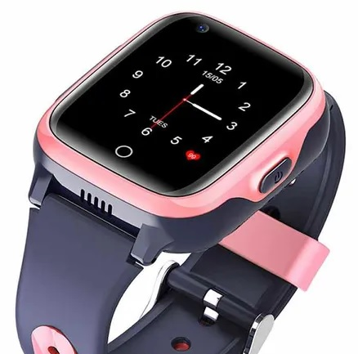
TrackO Watches Digital Marketing Campaign
DMDE Project Submitted by:
G Poornima
Paruchuri Renu Sree
Rohan Nathani
Rahbar Ali

Slide 2

About TrackO Watches
Manufacturers and Sellers of GPS Smartwatches for kids
Based out of Bangalore
Features of the watch
GPS,
Video/Audio Calling,
72 Hours battery,
Waterproof,
Fitness Apps & more

Slide 3
STP of TrackO Watches
Segment
Parents in Tier 1 and Tier 2 cities - upper middle class / higher income bracket
Who are educated and interested to invest in technology devices for self and children.
Target
Position
We will be targeting customers who are searching for location tracking watch/smart watch/fitness watch for their children.
We position ourselves as manufacturers and sellers of GPS Smartwatches at affordable prices.

Slide 4
4 Ps
Product – GPS Smartwatch TrackO Premium, TrackO Kids, TrackO kids Premium
Price – Rs. 12,000/- to Rs. 15,000/-
Place – Home Delivery to customers in Bangalore as Phase1 strategy. Later expansion to Tier 1&2 cities.
Promotion – Through Website, Google Ad, Facebook Page, Facebook Ad, LinkedIn Page, LinkedIn Ad, YouTube Channel, YouTube Ad.

Slide 5
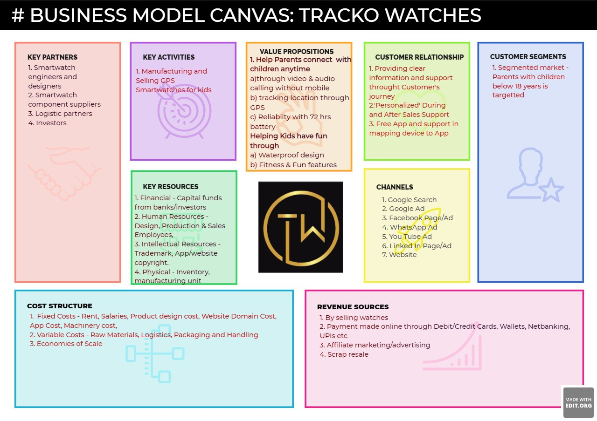

Slide 6
Links
Our Company’s website – https://pgk5984.wixsite.com/trackowatches
Our Company’s gmail id is Trackowatches@gmail.com
Our Linked In Account is TrackO Watches and LinkedIn Page is TrackO Watches
Our Facebook Account is https://www.facebook.com/profile.php?id=100084379754490
Our Facebook Page is https://www.facebook.com/trackowatches/
Our YouTube Channel is TrackO Watches
https://www.youtube.com/channel/UCZAbI3D-IcdLRbIh72V5d1Q

Slide 7
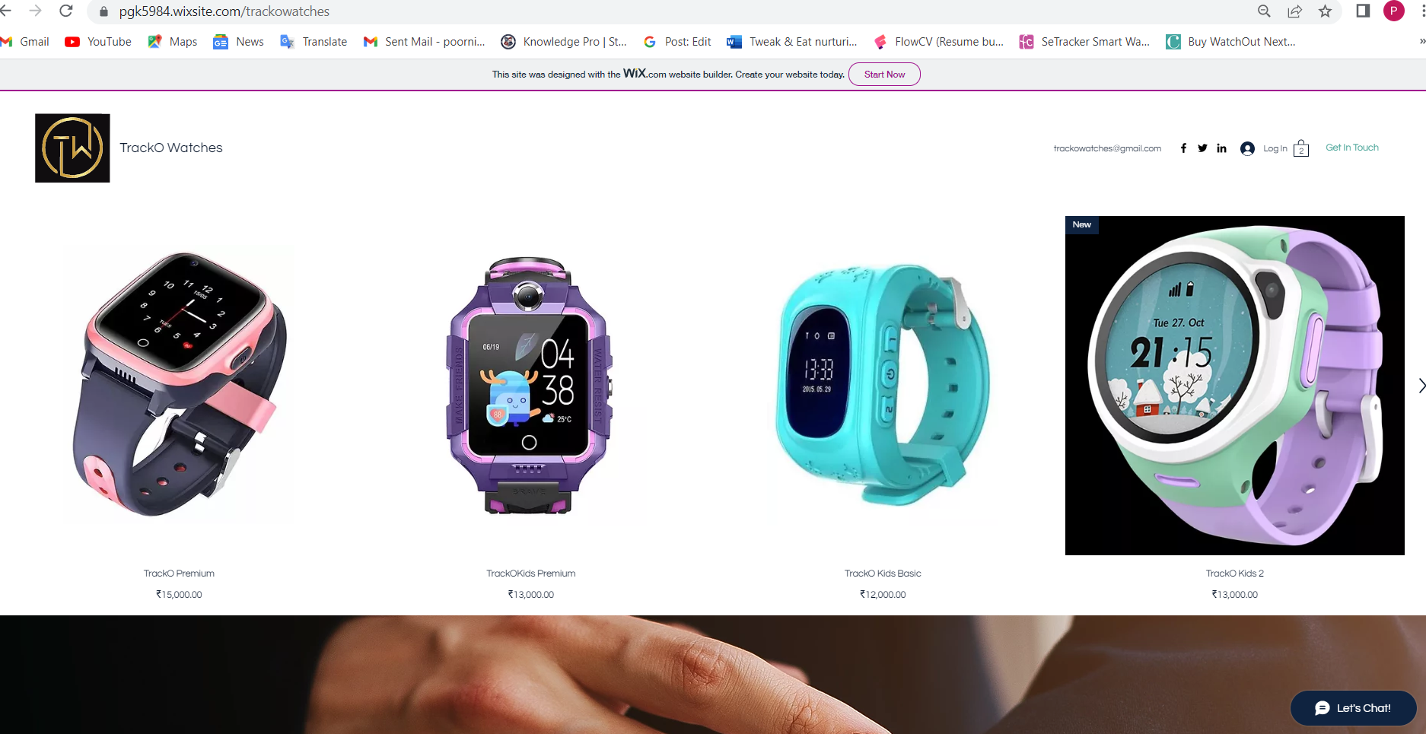
Our Website

Slide 8

Digital Marketing Campaign
Google Ad
YouTube Ad
Facebook Ad
LinkedIn Ad
This Photo by Unknown author is licensed under CC BY-SA-NC.

Slide 9

Google Ads
Campaign Objective – Website Traffic
Campaign Type – Search
Location – Bangalore, Anekal
Campaign duration – 28 Aug 2022 to 30 Aug 2022
Budget – Rs. 500/- per day
Keywords – 17

Slide 10
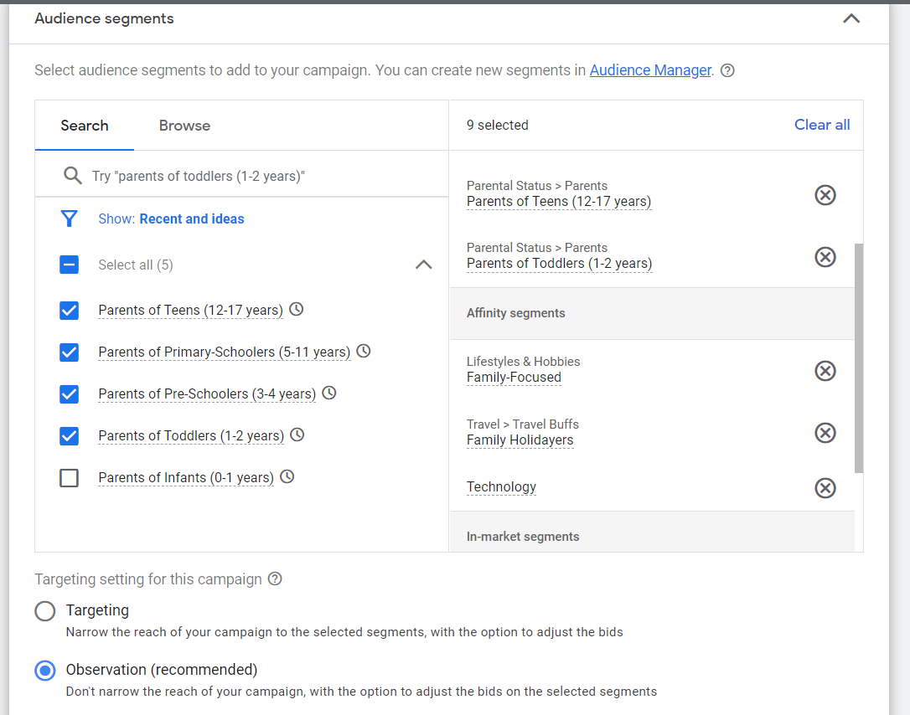
Google Ads - Audience

Slide 11
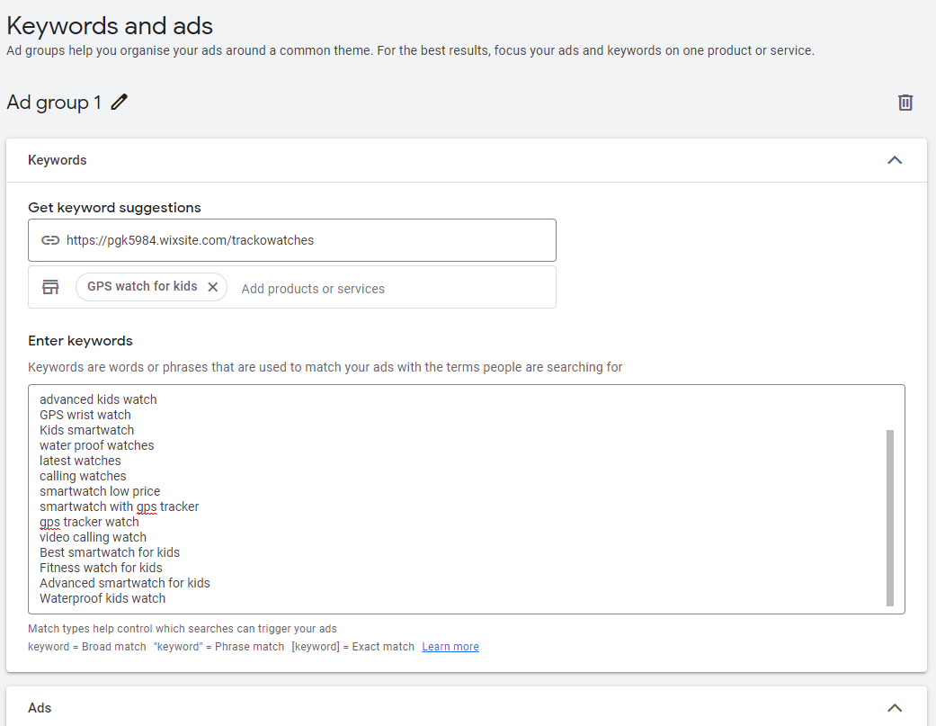
Google Ads - Keywords

Slide 12
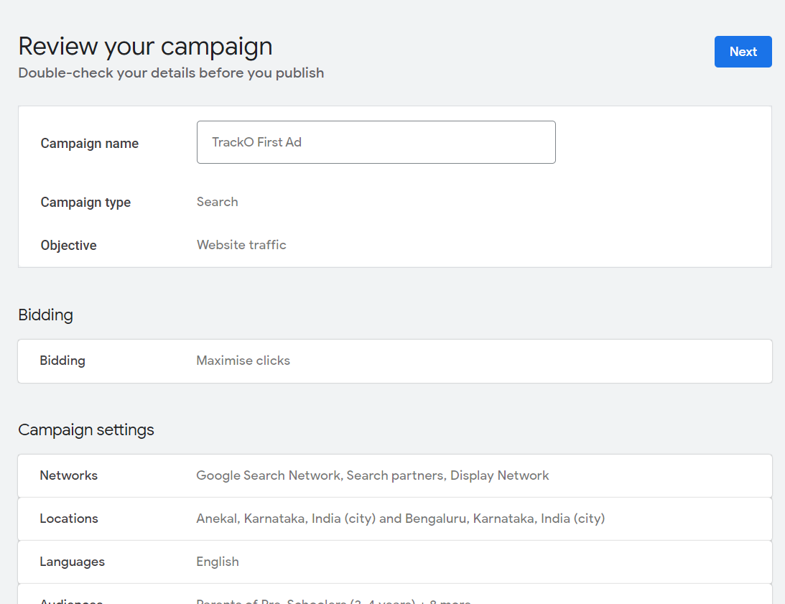
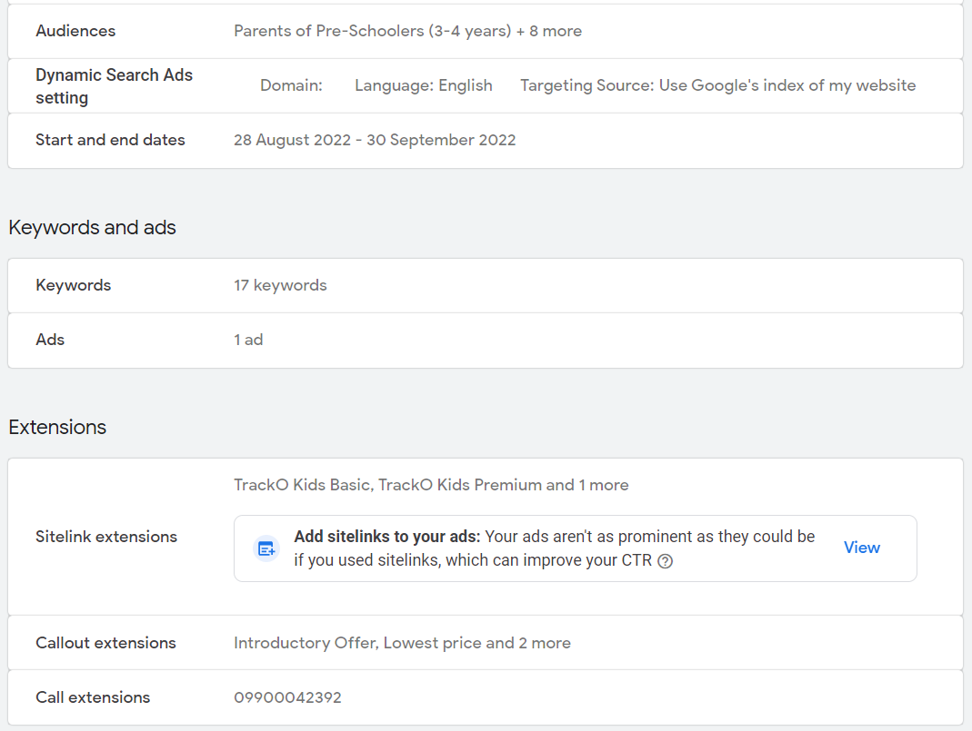
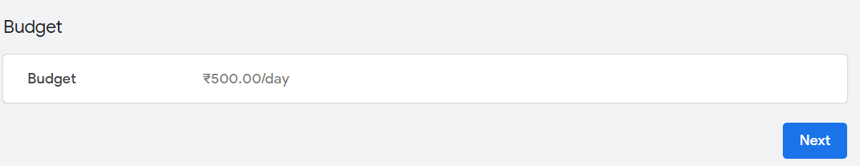
Review of Google Ads Campaign

Slide 13
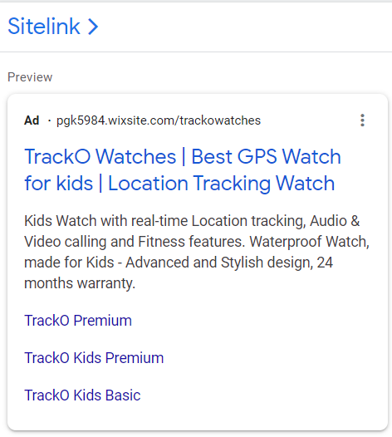
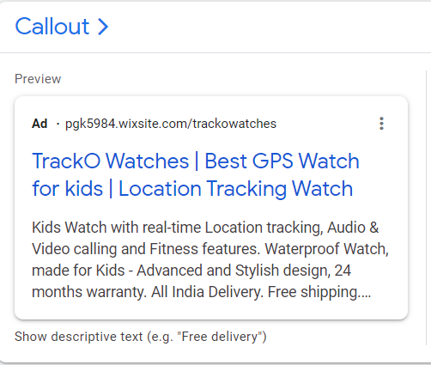
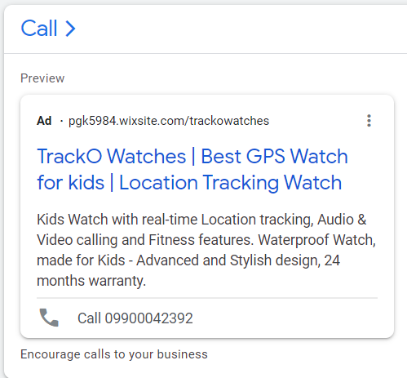





Preview of the Google Ads

Slide 14
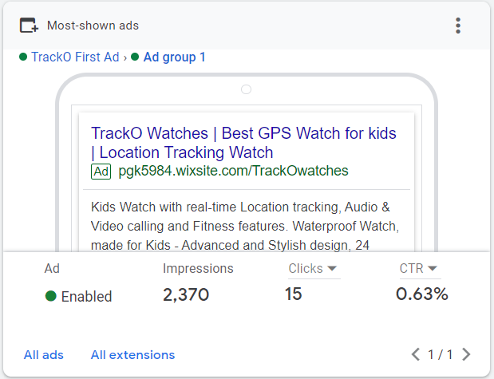
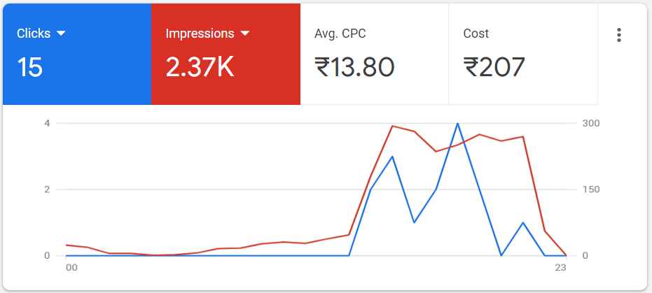
Google Ad Manager Stats

Slide 15
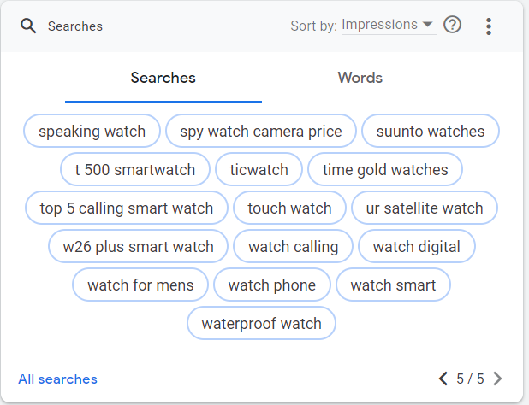
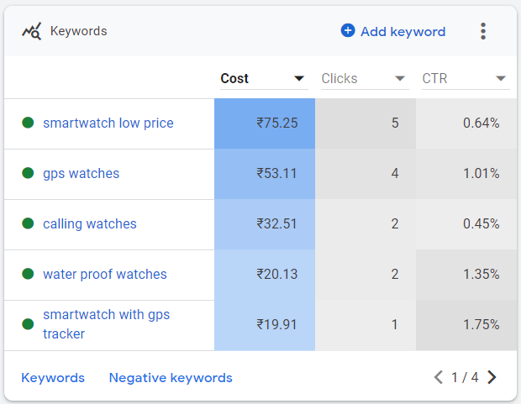
Google Ad Manager Stats

Slide 16
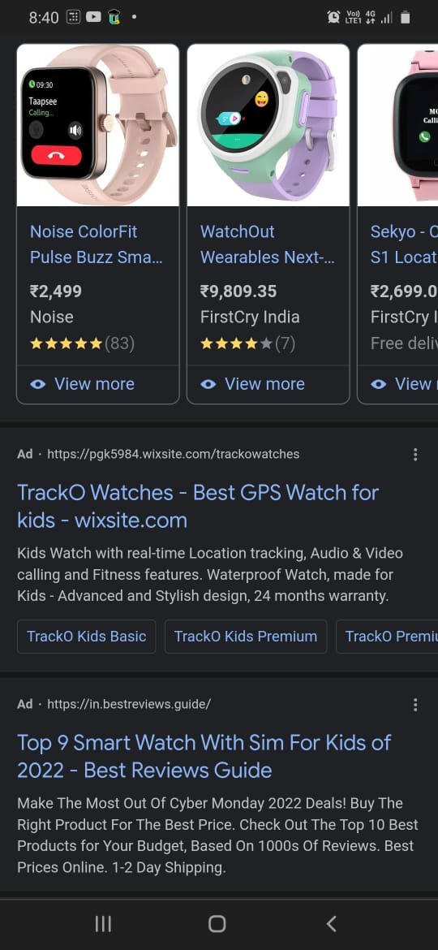
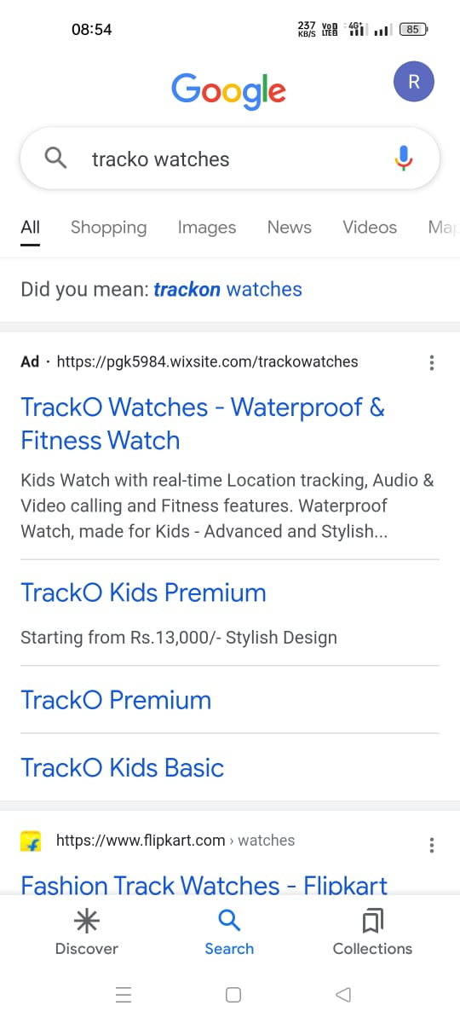
Google search results

Slide 17
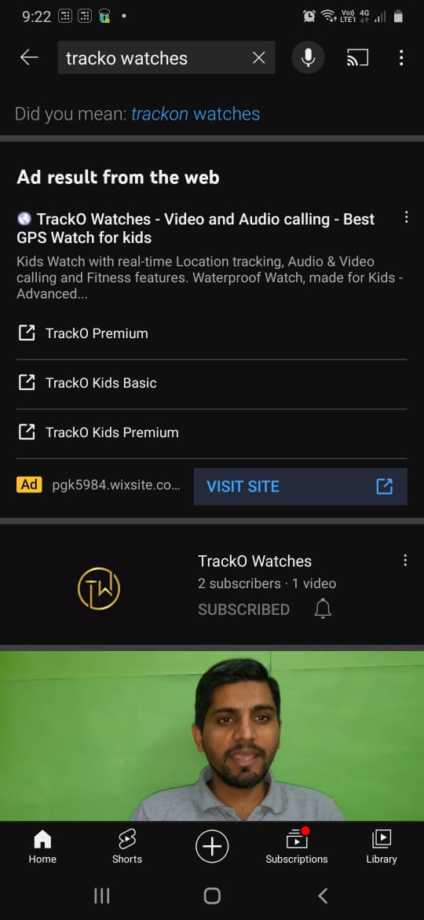
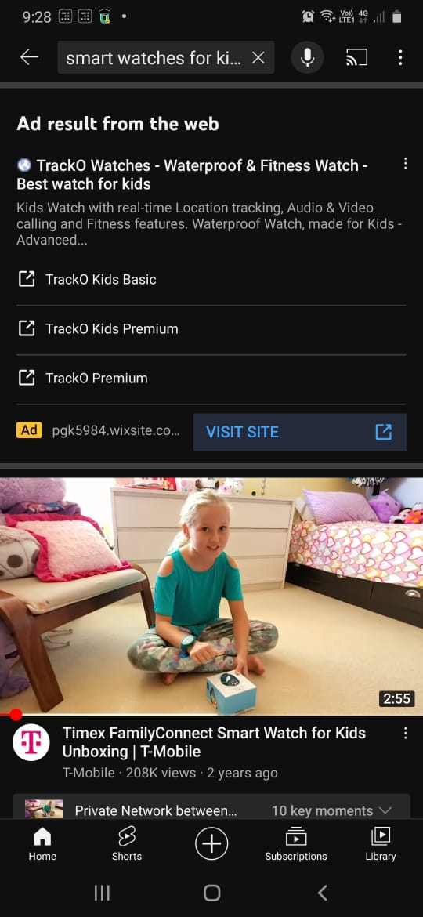
Google Ad appearing in Youtube search

Slide 18
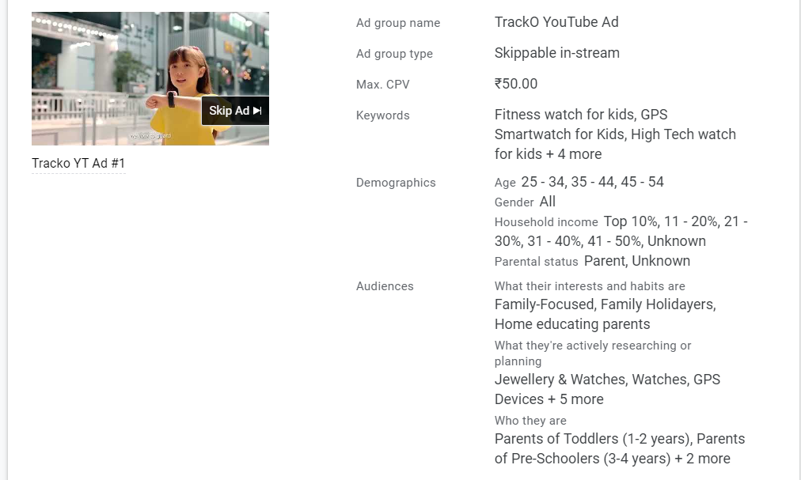
YouTube Ad Summary

Slide 19
YouTube Ad Link
https://www.youtube.com/watch?v=VSCkrvtVt3Y&force_ad_encrypted=AD7yQuLLAqnYROy8OtjElROAcDFRgaRTAPRvfNFlhiAIzlq8m5HoXmH4PLsWtPjoZRJ88BahbYEZjXnwoRhlsfTqCbrhGv4GYJ06Vvlgcewz4QV8xlgiDTLYv0FrGjlTf1FUvnMfhzCqiWt3rAQn2BbQU7XMjEzKJPiVlJkK-DQNkTV1_RvoElFwJ9aqxYxRwlPmrtkN_qEBq2arq5NDtNq2MICCDTVaazSjvPWkJyO63aK92HOBYgoE6j_VcZWIa8DT4ulkmaiUCVEWomnNH5-sZgdtfphNC1GtcxbZkjRlE8V5Z0A4Yleyw1mSfKTojrksRbmb24dm84qNB53GraMOPp6iWZXuiCI6hMhNb--RZVP5ias_L8ubbTb9KDSaxbSpsm5RhXxOuG8WVohnaQ-N9L5D6C-aWm2DLzFtqO4QKeBBoFuDdFxFv4nX_R5BGqAa0XDmv4xfYH_ozKbwpOkbQfLS_sNdErAw_tfswFDzpSVeln3J2yg9Kso6oSFwefpExzhEUZ7jwCwgXpNOHcrY75fyuZ13VX2CRpGRb9pQ8Xzg0fJ6A2_7A0ORKZawhMBLgC_yBPHFMW-bLXrRWsX1GsOVg_y6C50yR5zXKHfT-a2sujQKkI1cajUMLdCjnhMOpd3L3sqgDpyZsn94G1XKjoaaWikCrnAi5WFo215HyXBJS0Hlwj8%3D

Slide 20
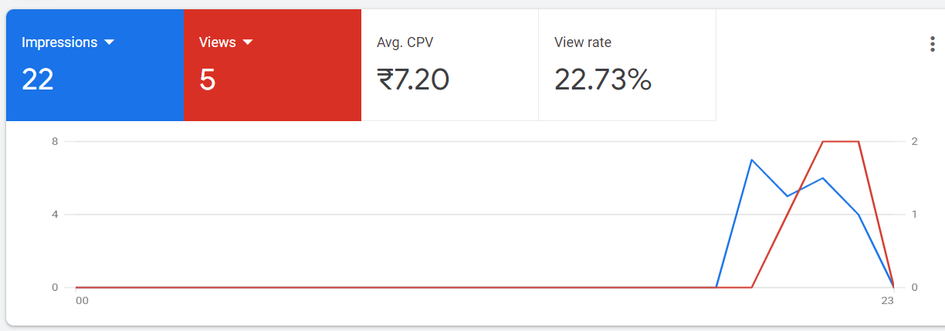
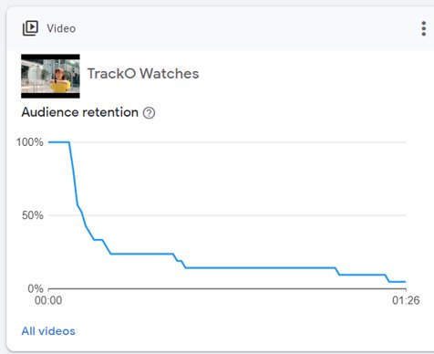
YouTube Ad Stats

Slide 21
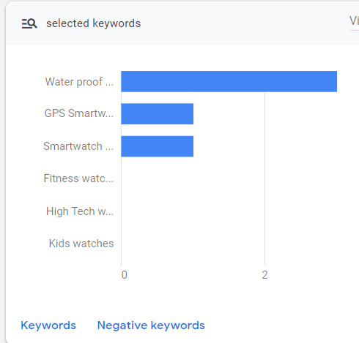
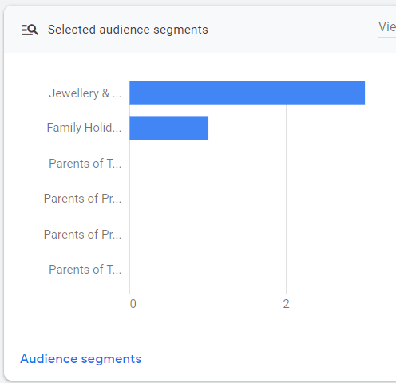
YouTube Ad Stats

Slide 22
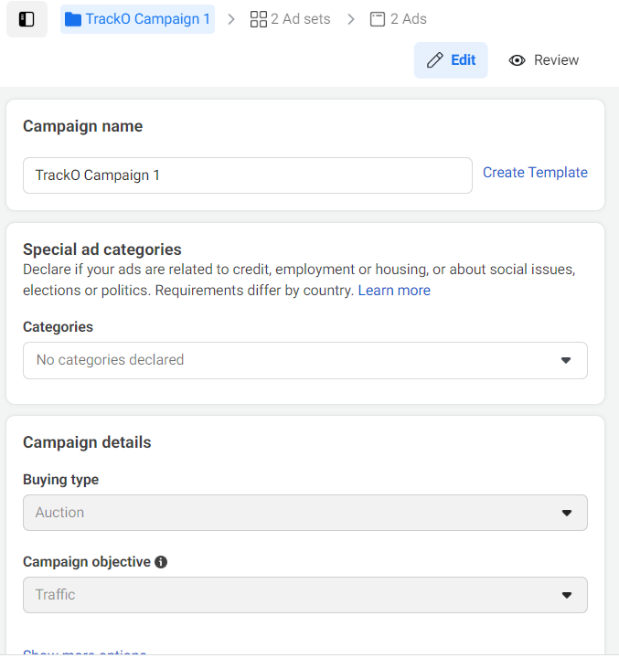
Facebook Campaign

Slide 23
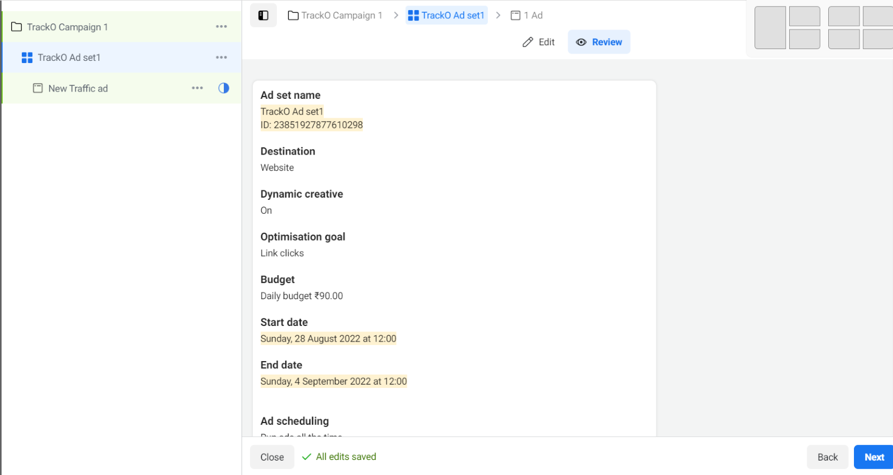
Facebook Ad
Objective – Web Traffic

Slide 24
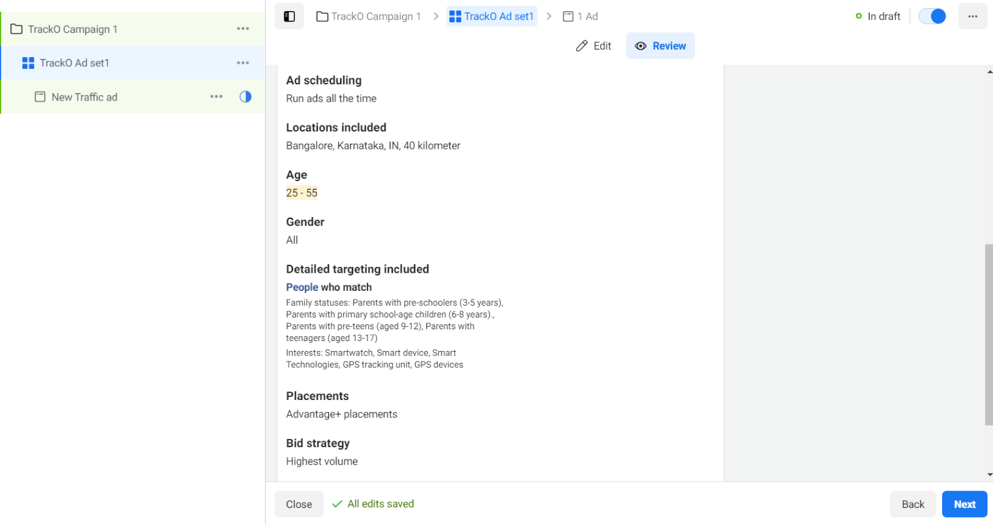
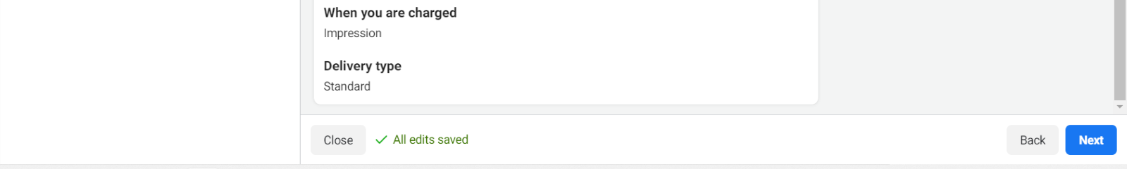
Facebook Ad

Slide 25
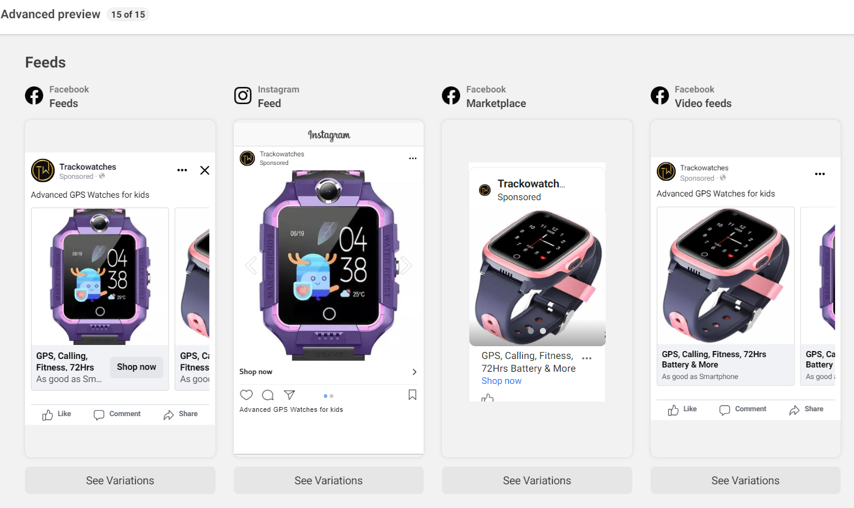
Facebook Ad on other FB network

Slide 26
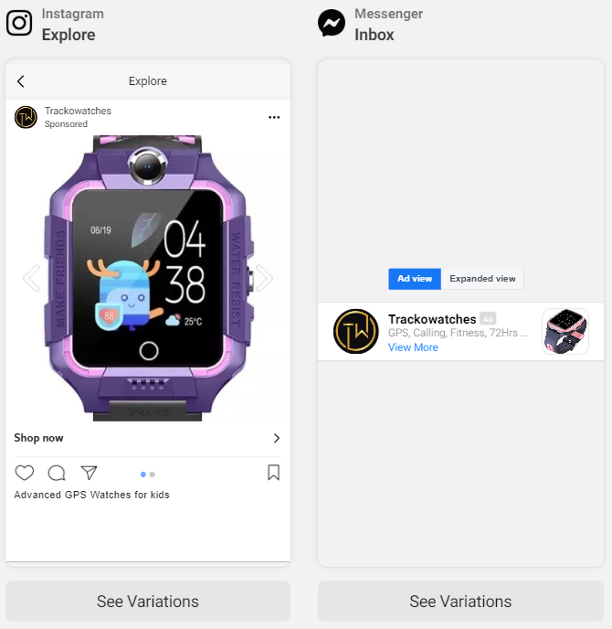
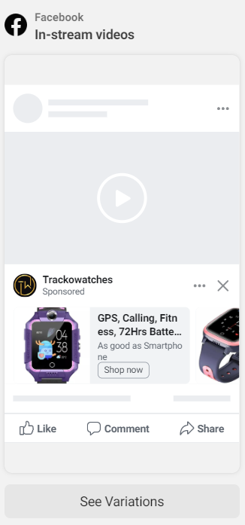
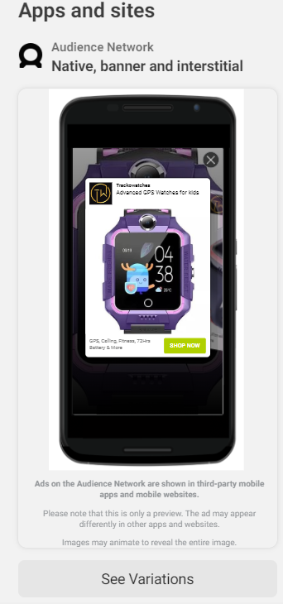

Slide 27
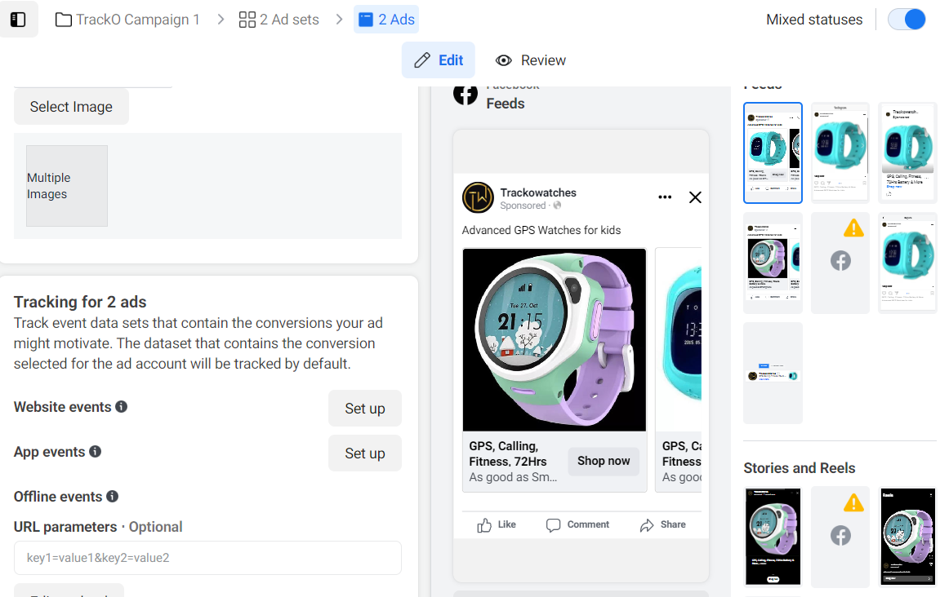
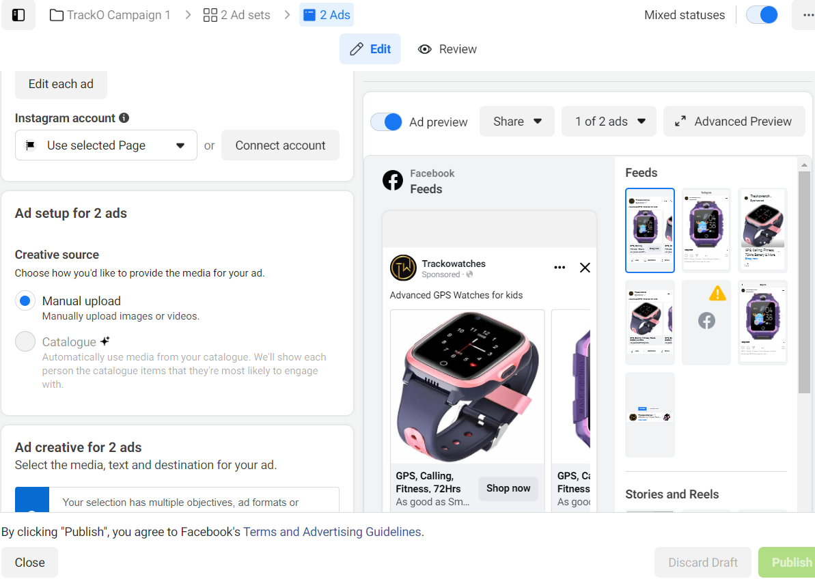

Slide 28
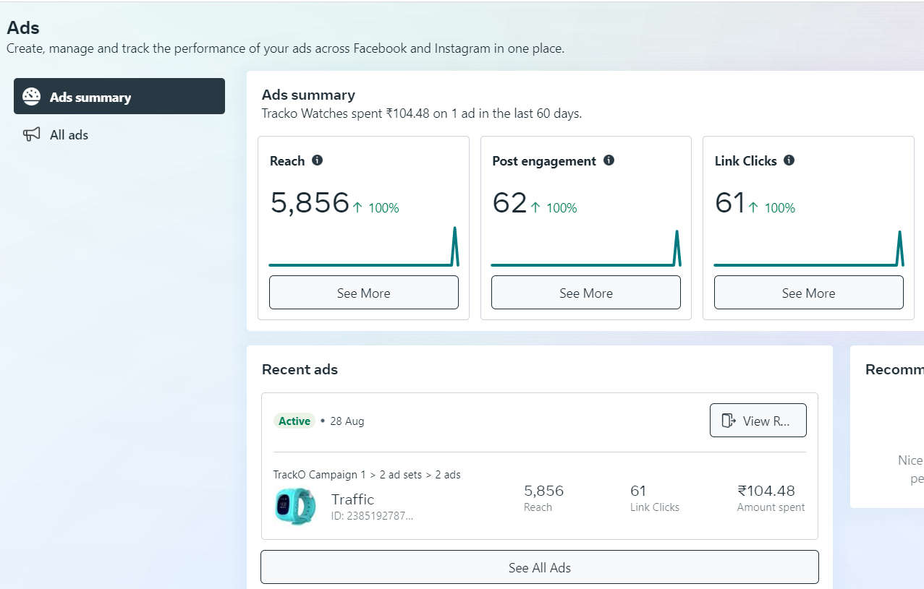

Slide 29
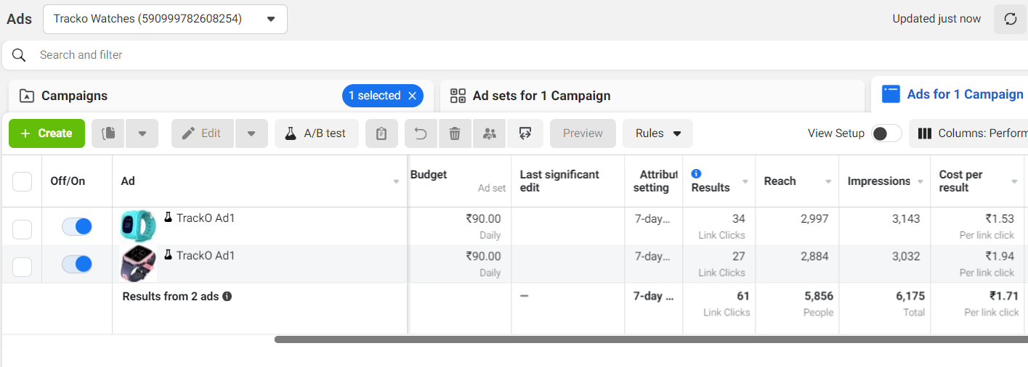
2 Ads with different Images - A/B testing

Slide 30
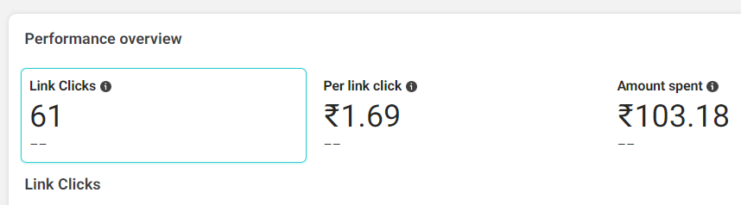
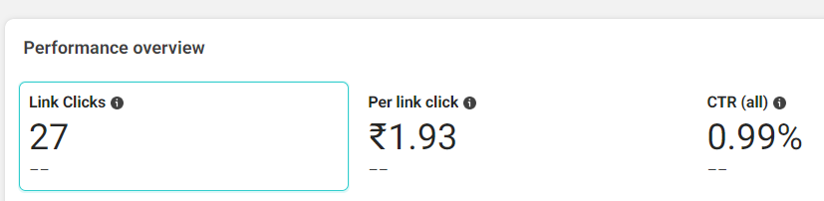
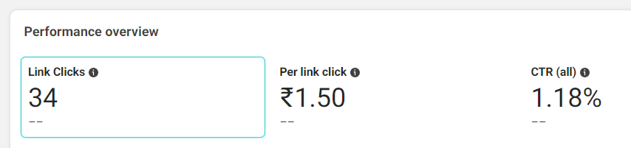
Facebook Ad Manager Stats
Overall Campaign
Creative 1
Creative 2

Slide 31
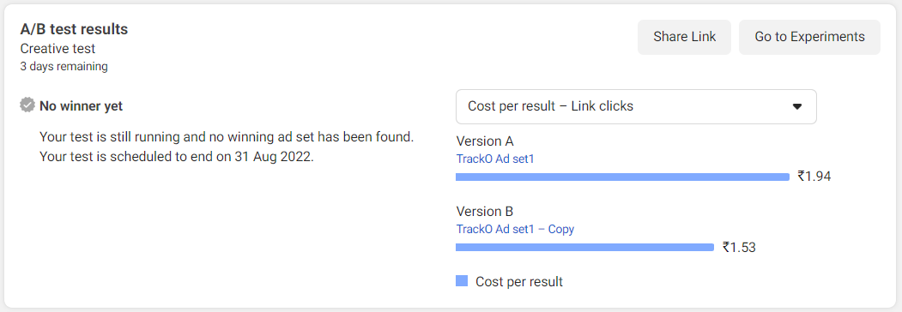
A/B [2 creatives] test results

Slide 32
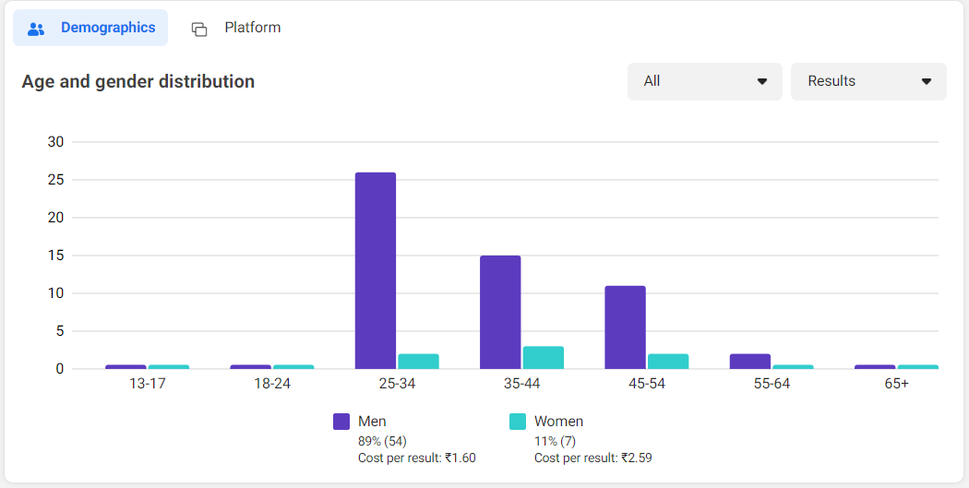
Overall Campaign Stats

Slide 33
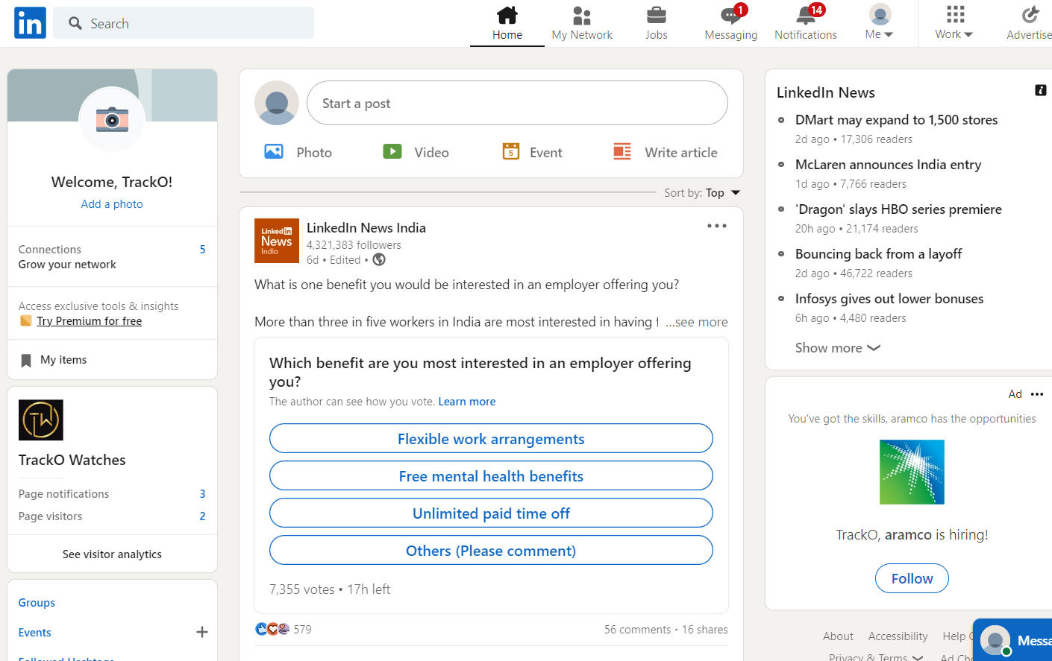
Linked In Page

Slide 34
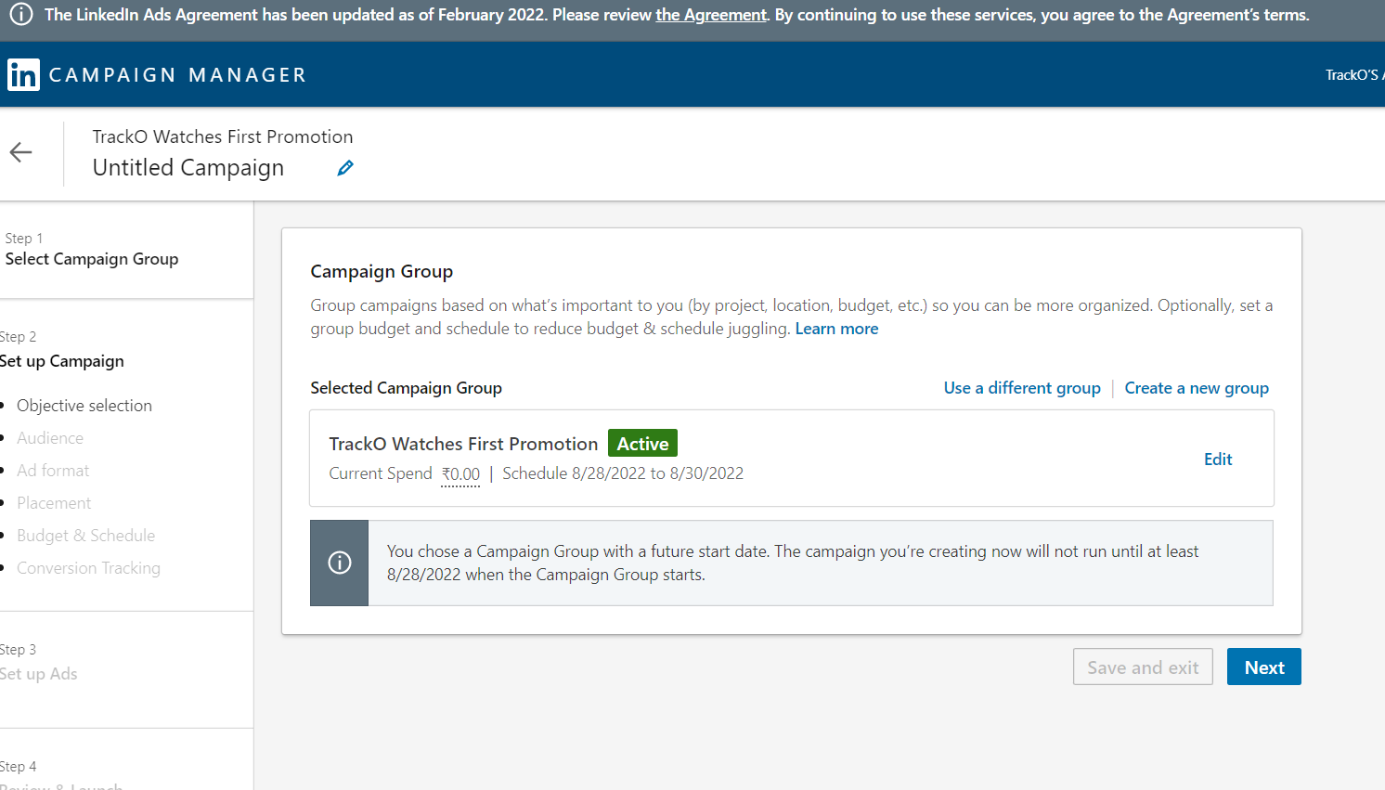
Linked In Ad creation

Slide 35
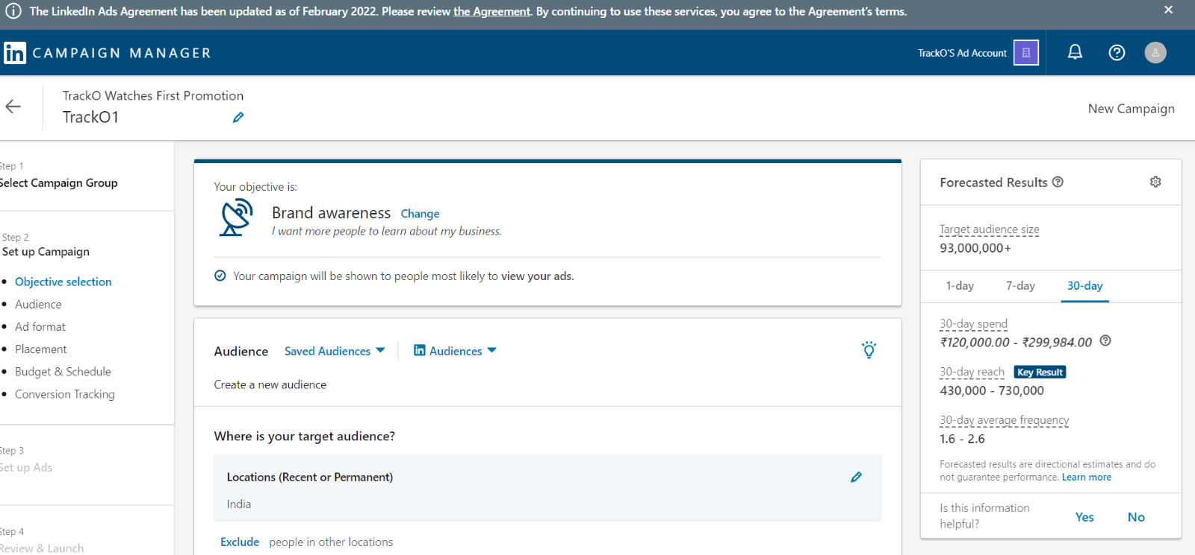
Linked In Ad creation

Slide 36
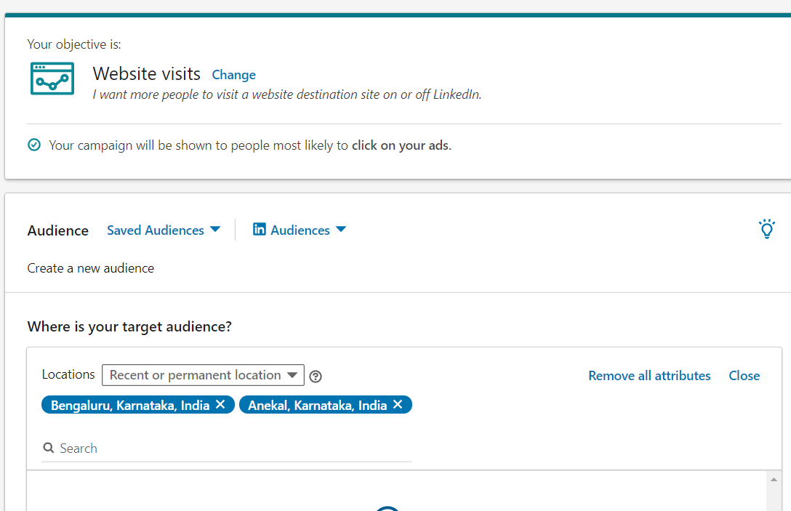
Linked In Ad creation

Slide 37
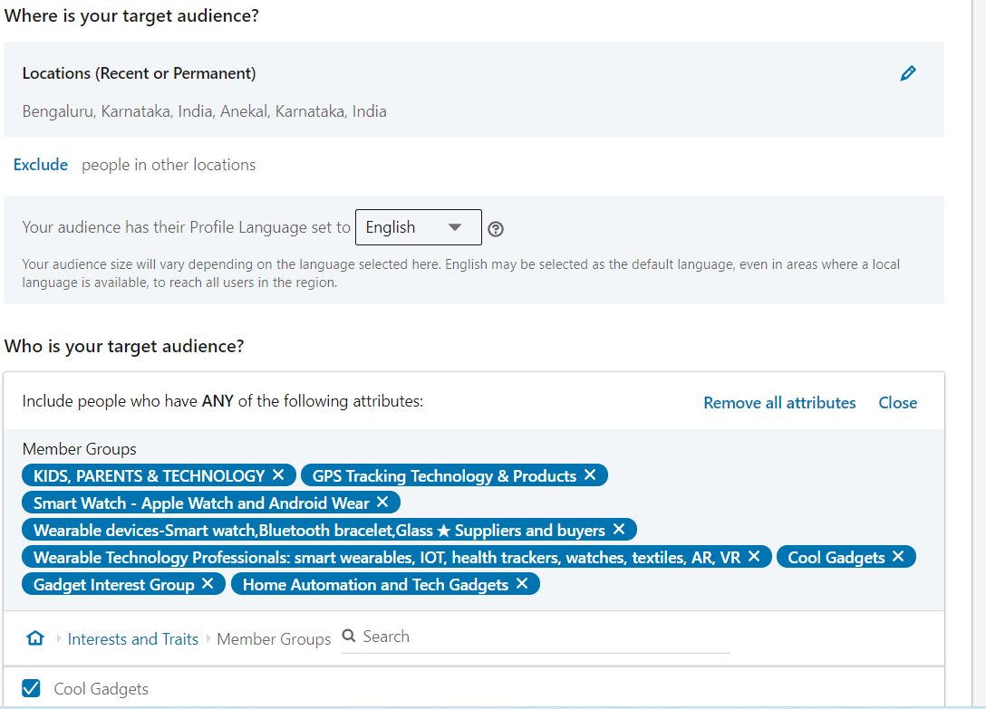
Linked In Ad creation

Slide 38
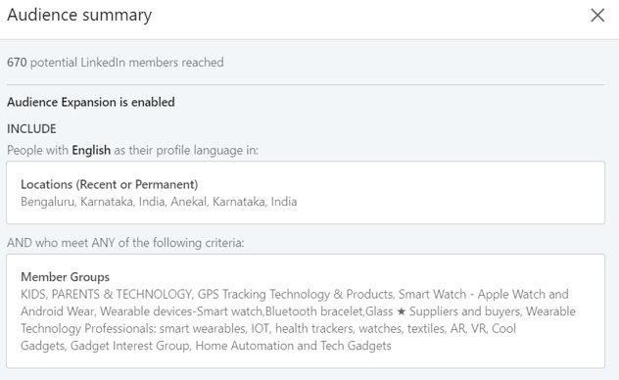

Slide 39
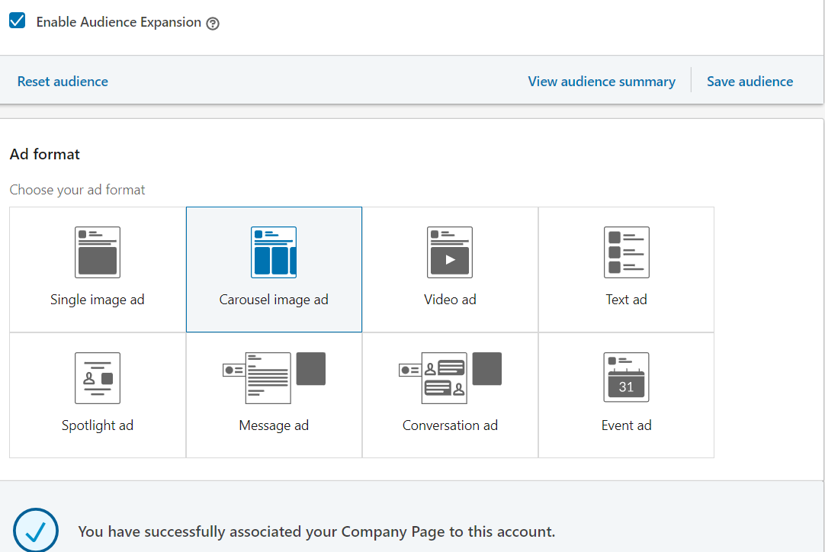
Linked Ad creation

Slide 40
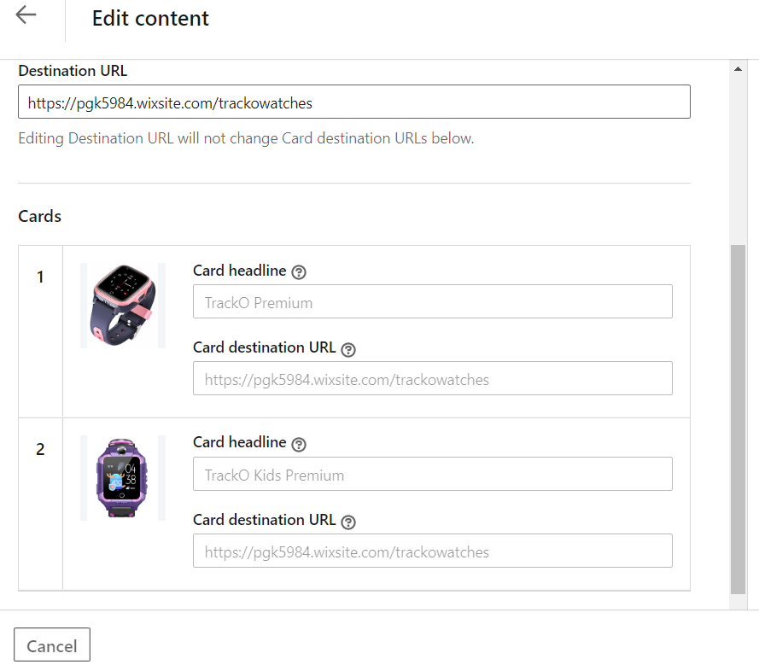
Carousel Ad creation

Slide 41
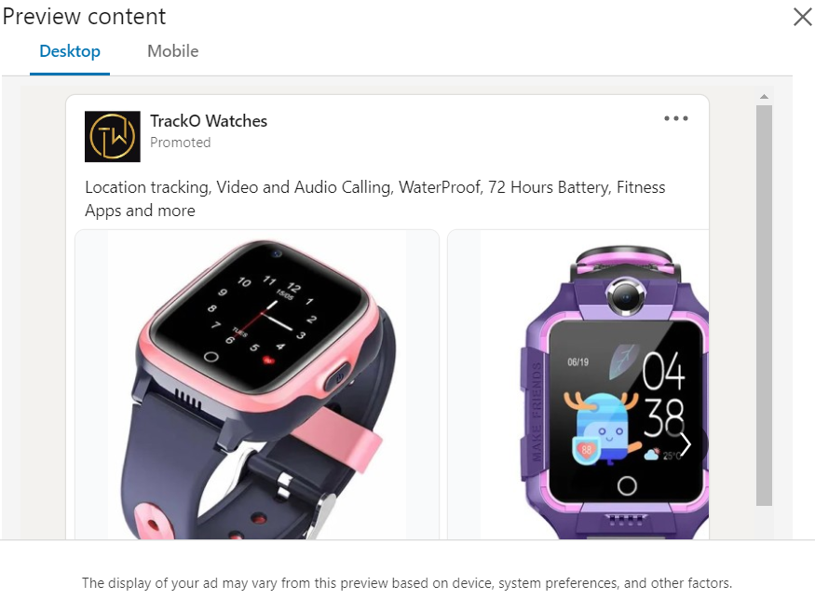
Carousel Ad preview

Slide 42

Carousel Ad preview

Slide 43

Ad Summary

Slide 44

THANK YOU

